Slide 1

Optimizing Delivery Timing:
A Machine Learning Approach to Predicting Late Shipments
Group 33: Hamza Alshamy, Sunny Son, Alexandra Halfon

Slide 2
Content
Data Overview
Dataset | Research Question | Merging
Pre-processing and EDA
Feature/Outcome Engineering | Data Plots
Modeling
Random Forest | Evaluation Methods | Feature Importance

Slide 3
Data Analysis and Research Question
Data: From Kaggle, we use the Brazilian E-Commerce Dataset by Olist, containing multiple tables regarding purchase transactions.
Objective: Predict whether an order will be delivered late given a host of features.
Target Variable: A binary variable indicated whether delivery date > estimated delivery data.
Features: Delivery carrier date, order status, order items (size/weight), customer location, and seller location.
Workflow: Data Importation ⇒ Joining Tables ⇒ Grouping Data ⇒ EDA/Visualizations ⇒ Modeling ⇒ Conclusions
Analytical Tools & Methods
Summary Statistics: Analyze average time from order placement to approval, assess weekend orders’ effect on delivery, explore the effect of distance between buyer and seller.
Heat Maps and Box Plots: Visualize the distribution, spread, and skewness of delivery times across different regions or seller locations, showing where delays are more prevalent.
Correlation Analysis: Investigate relationships between different features (e.g., delivery carrier date, order size, weight, customer and seller locations) and late deliveries.

Slide 4

Dataset
Exploring features:
orders_dataset: order_id, customer_id
order_items_dataset: seller_id, shipping_limit_date, price
products_dataset: product_weight_g, product_length_cm
customers_dataset: customer_id, customer_city, customer_zip_code_prefix
sellers_dataset: seller_id, seller_zip_code_prefix, seller_city
geolocation_dataset: geolocation_zip_code_prefix, geolocation_lat, geolocation_lng

Slide 5
Merging Datasets
Loaded in dataset
For geolocation_dataset we generalize each zip code by the latitude and longitude of the first row line-item for each zip code
Inner join: order_items_dataset ⇔ sellers_dataset ⇔ geolocation_dataset ⇔ order_customer_dataset
Various design choices for merging: how to process products with different freights within each, inner vs. other types of join
Originally considered non-aggregation of geolocation and zip-code, which would have resulted in cross-multiple effects given multiple geo-locations per zip code
Decided to go with inner-merge for consistency of merges across all tables

Slide 6
Feature Engineering
Feature Engineering: Selecting, manipulating and transforming raw data into features that can be used in supervised learning. Used pandas date/time series functionality for variables for datetime objects.
distance (Continuous): Distance between buyer and seller
Used Haversine formula to calculate the distance between coordinates (x₁,y₁) and (x₂,y₂) on a sphere
Haversine formula:
time_to_ship_hours (Continuous):
A transformation of two variables: i) order_approved_at and ii) order_delivered_carrier_date
weekend_order (Binary):
Converted the order_purchase_timestamp column to datetime format and extracted the day of the week to create a binary weekend_order feature (1 for weekends, 0 for weekdays).
season (Categorical – One-hot Encode):
Created a season column by mapping months from order_purchase_timestamp to their respective seasons
One-hot Encode: Spring (binary), Summer, and Winter

Slide 7
Outcome Engineering, Overview, and Pre-processing Checks
Outcome (Binary):
Features:
Continuous | Freight Value | Product Weight (g) | Product Length (cm) | Product Height (cm) | Product Width (cm) | Distance (Km) | Time to Ship (hours)
Binary | Weekend order (1 or 0) | Spring (1 or 0) | Summer (1 or 0) | Winter (1 or 0)
Class Imbalance:
Is_late == 1: 8626 rows (~8%)
Is_late == 0: 99,466 rows (~92%)
There is a significant class imbalance
Non-negative Values:
Time_to_ship_hours
Min: -4000 hours ≈ 5 months
All other variables had non-negative values

Slide 8
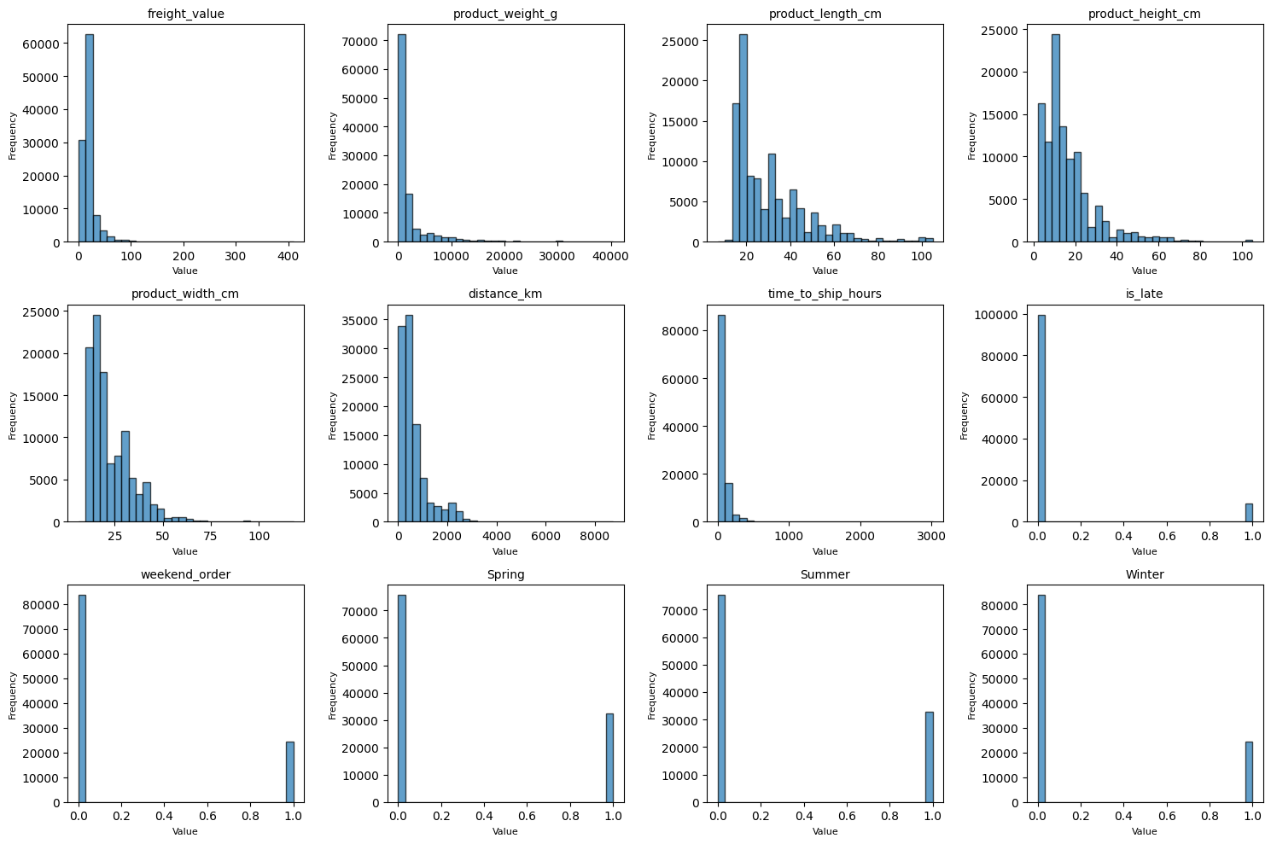
EDA: Understanding Data Distributions

Slide 9
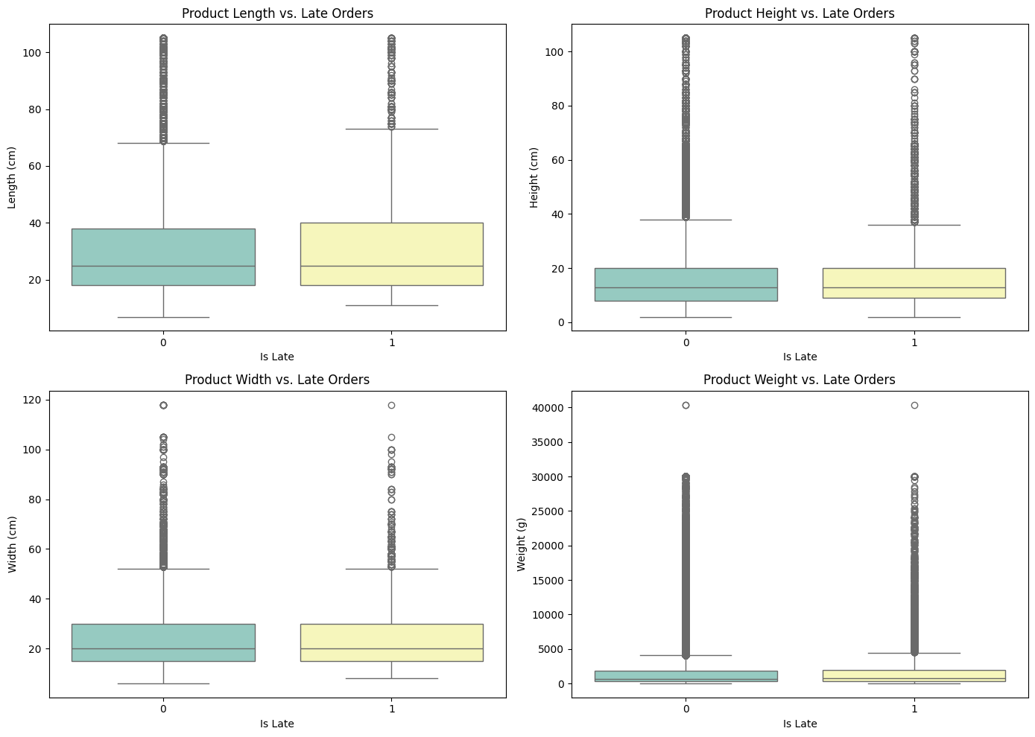
EDA: Order Dimensions Boxplot
Notes:
Median Values do not differ significantly between late and non-late orders
Product Weight shows a wider range and more extreme outliers compared to the other dimensions
There is no strong visual evidence that product dimensions directly impact the order status (being late)

Slide 10
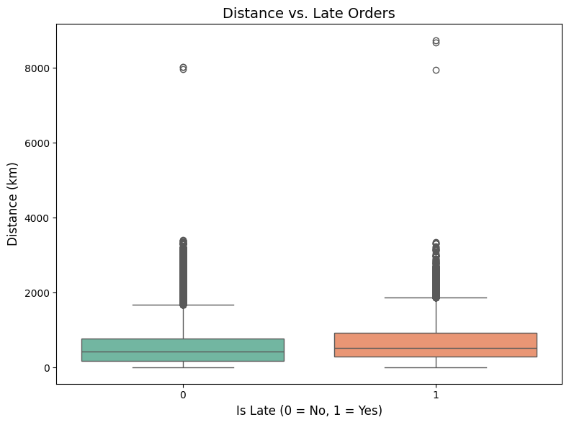
EDA: Distance Impact on Order Status
Comparison of Median Distance
Late orders (1) have a slightly higher median distance compared to on-time orders (0)
Spread of Distances
Both groups show a wide range of distances, but late orders exhibit slightly greater variability in the interquartile range (IQR)
Presence of Outliers
Significant outliers are present in both late and on-time orders

Slide 11
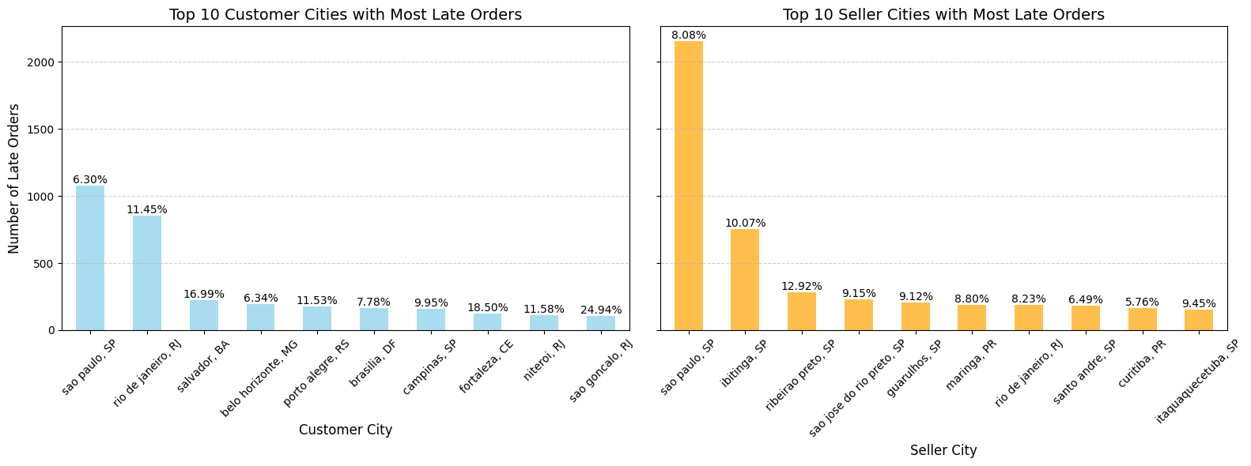
EDA: Top Cities Contributing to Late Orders

Slide 12
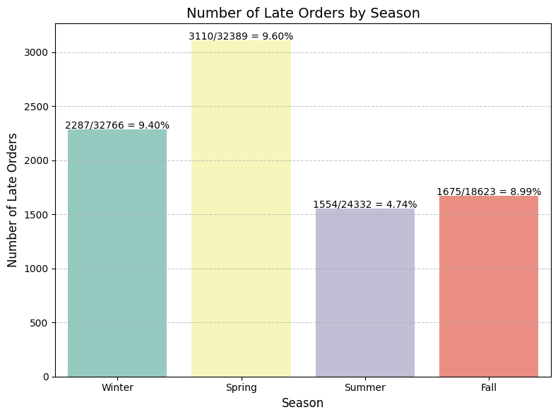
EDA: Number of Late Orders by Season

Slide 13
Modeling
Random Forest
Goal: Build an ensemble of decision trees that classify whether an order will be late or on time, capturing complex interactions and non-linear relationships among features like delivery carrier date, order status, and locations.
Loss Function: Gini Impurity – Used within each decision tree to determine the optimal splits, minimizing impurity at each node and helping achieve more accurate predictions
Evaluation Metrics
Accuracy: Ratio of correctly predicted instances (both positive and negative) to the total number of instances in the dataset (the proportion of correctly predicted orders (both late and on-time) out of the total number of orders)
Precision: How many of the predicted positives are actually positive (how many of the orders predicted as late were actually late)
Recall: How many of the actual positives were correctly predicted (the proportion of true late orders that were correctly predicted)
Area Under the ROC Curve (AUC): Assesses the model's ability to differentiate between late and on-time deliveries across different thresholds
Consideration: The dataset contains more on-time deliveries than late ones; therefore, we must address class imbalance when evaluating the models

Slide 14
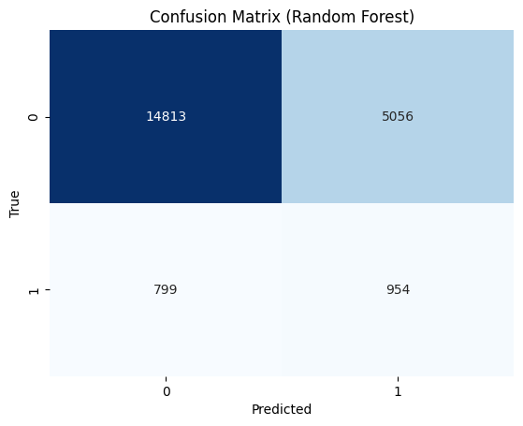
Model Evaluation
Goal: Increase true positives for late orders (late orders correctly predicted as late)
Approach: Optimizing the hyperparameters of the classifier to increase recall for the minority class (late order) while maintaining a balance of a moderate AUC
class_weights, max_depth
By optimizing recall, we allow for some misclassification (more false positives) to increase correct classification of late orders (more true positives)
i.e., we are sacrificing more "not late" orders being incorrectly predicted as "late" so that more “late” orders are correctly predicted as “late”
Reasoning: It's better to overpredict late orders and deliver an order earlier than estimated than to miss capturing a late order and disappoint the customer
Recall (1): the proportion of actual late orders correctly predicted by the model (True = 1, Predicted = 1)
The model correctly identifies 57% of late orders

Slide 15
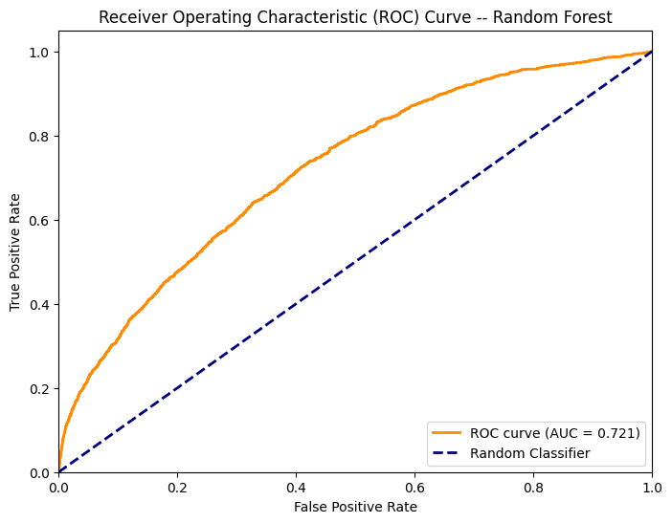
Model Evaluation: Metrics
Metrics
AUC: 0.721
Non-late Orders:
Precision: 0.95
Recall: 0.73
The high precision indicates that the model is effective at identifying non-late orders with minimal false positives
Late Orders:
Precision: 0.15
Recall: 0.57
The low precision and moderate recall suggest that the model increased its recall at the cost of high false positives
The model is better at capturing non-late orders.

Slide 16
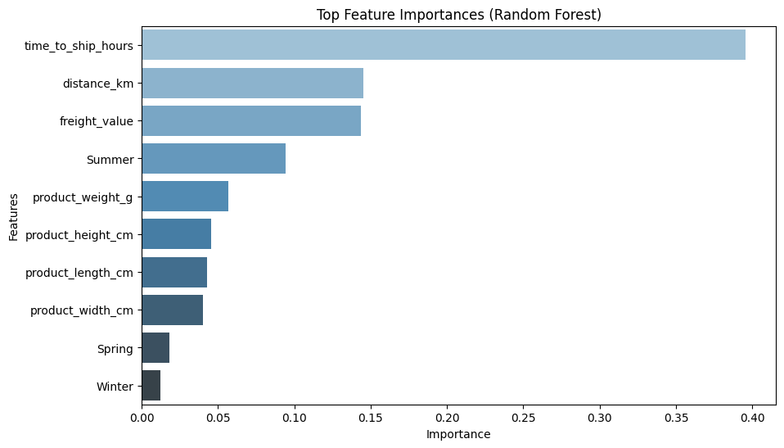
Features Importance
The bar plot below shows the top 10 features by importance, where the importance value indicates the relative contribution of each feature to the model's decision-making process.
Features with higher importance values are more influential in predicting the outcome.
From the random forest model, we found that the most important feature in predicting late deliveries is time_to_ship_hours, which has an importance value of 0.396 (39.6%)
This suggests that the longer the time required to ship the product, the more likely the order is to be late
Other Key Features
distance_km: 14.5% importance
freight_value: 14.3% importance
Summer: 9.4% importance
product_weight_g: 5.7% importance
product_height_cm: 4.6% importance
product_length_cm: 4.3% importance
product_width_cm: 4.0% importance
Spring: 1.8% importance
Winter: 1.2% importance

Slide 17
Q&A
Thank you

